Slide 1








A
ll
Th
in
gs
open
Good Code Documents itself and other lies
Changing work culture through documentation
Tania Allard, PhD
Developer Advocate @Microsoft
ixek

Slide 2


Takeaways
Your takeaways
What is technical debt?
Documentation as the entry point for paying technical debt
Some useful tips to use docs to drive change
@ixek

Slide 3
who likes writing documentation?
@ ixek

Slide 4
who actually writes documentation as a regular practice?
@ixek

Slide 5
What if you could change your work culture…
writing documentation?
@ixek

Slide 6
and pay some technical debt?
@ixek

Slide 7

What is technical debt?

Slide 8


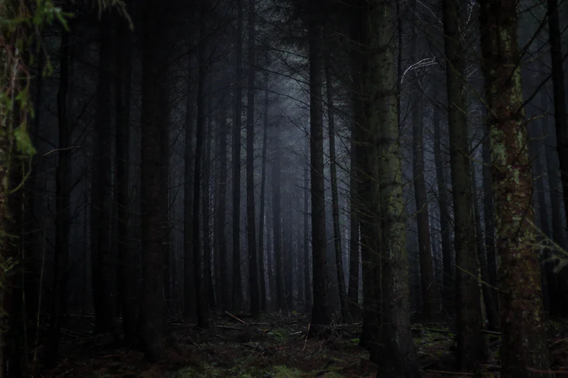
It’s like the monster under your bed
@ixek

Slide 9


Technical debt
A series of bad decisions
Leading to error prone code & architecture
@ixek
Notes:
Bad decisions technical and managerial

Slide 10
Technical debt
A series of bad decisions
Leading to using resources unnecessarily
@ixek
Notes:
Bad decisions technical and managerial

Slide 11

What decisions were made in the past?
That prevent me from getting stuff done today
@ixek

Slide 12


What causes technical debt?
You and me
@ixek
Notes:
Me and you: not saying no to features, not prioritising tests or security

Slide 13

Time crunch
That project was due yesterday!
I’ll come back and clean tomorrow… or add the docs tomorrow
@ixek

Slide 14

Unnecessary complexity
@ixek
Notes:
Me and you: not saying no to features, not prioritising tests or security

Slide 15
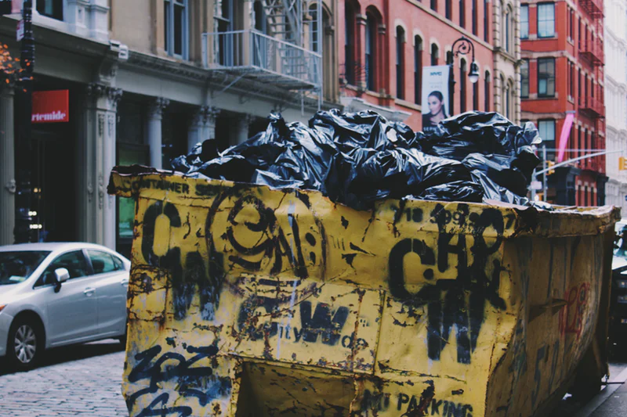
An already broken culture
All of our code is a pile of garbage… so nobody will notice if I add to the pile
@ixek

Slide 16
Identifying technical debt
@ixek

Slide 17
Code Smells
Indicators of a deeper problem (not bugs necessarily)
Half-baked features
Commented out pieces of code
No test / broken tests
Multiple versions of CI/CD but only one in use
No documentation or poor documentation
@ixek
Notes:
Running out of time, not my responsibility, the others do not document, we are not Microsoft or Google, who is going to read it, I will be irreplaceable

Slide 18
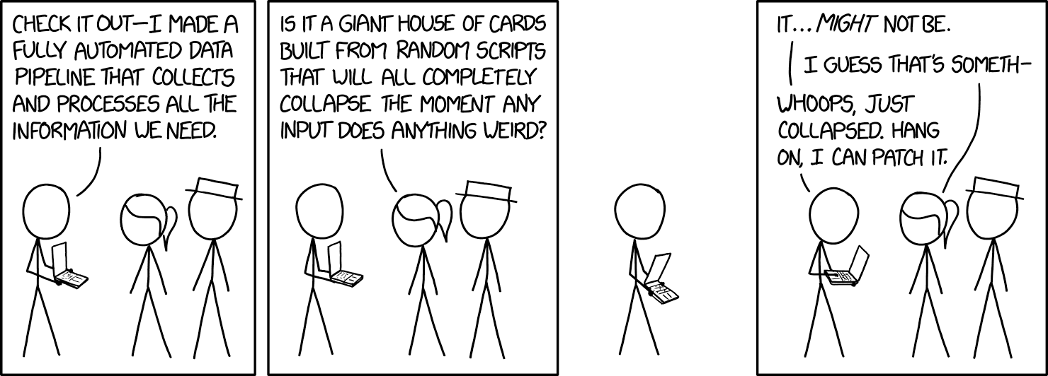
House of cards effect - Infra smells
https://xkcd.com/2054/
@ixek

Slide 19
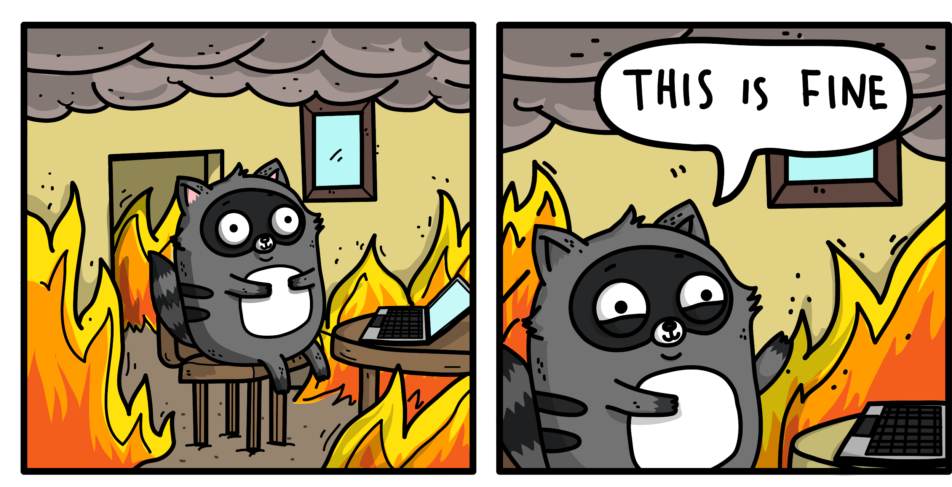
Everything is on FIRE - all the time
Courtesy of Ashley Mcnamara
@ixek

Slide 20
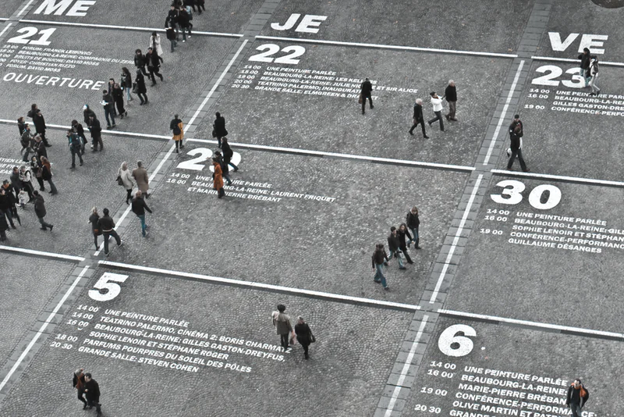
Unstable or underutilized data dependencies
@ixek
Notes:
Unstable - To move quickly, it is often convenient to consume signals as input features that are produced by other systems. However, some input signals are unstable, meaning that they qualitatively change behavior over time
Underutilised
legacy features: added in the past and now are redundant
bundled features: time churn bundling all the data sources together
epsilon features: It can be tempting to add a new feature to a model that improves accuracy, even when the accuracy gain is very small or when the complexity overhead might be high. In all these cases, features could be removed from the model with little or no loss in accuracy. But because they are still present, the model will likely assign them some weight, and the system is therefore vulnerable, sometimes catastrophically so, to changes in these unnecessary features.

Slide 21

Pipeline jungles
@ixek
Notes:
Without care, the resulting system for preparing data in an ML-friendly format may become a jungle of scrapes, joins, and sampling steps, often with intermediate files output. Managing these pipelines, detecting errors and recovering from failures are all difficult and costly

Slide 22


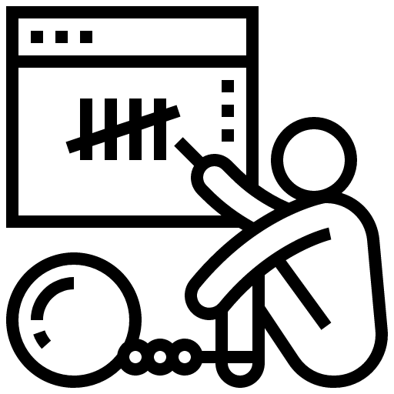
Which is easier to do?
Burning everything to the ground
Refactor your code base
Change your work culture -> make everyone accountable instead of pointing fingers
@ixek

Slide 23
Which is More impactful to do?
Burning everything to the ground
Refactor your code base
Change your work culture -> make everyone accountable instead of pointing fingers
@ixek

Slide 24
Story time
@ixek

Slide 25

You are given a present
But you have to figure out how to put it together
With no instructions
@ixek

Slide 26

You are given a present
Some pieces might be missing so you will have to “build them as you go”
With minimal or no instructions
Some pieces will never fit
So you will need to build more pieces
Your present might never work - as you’d expect it
@ixek

Slide 27
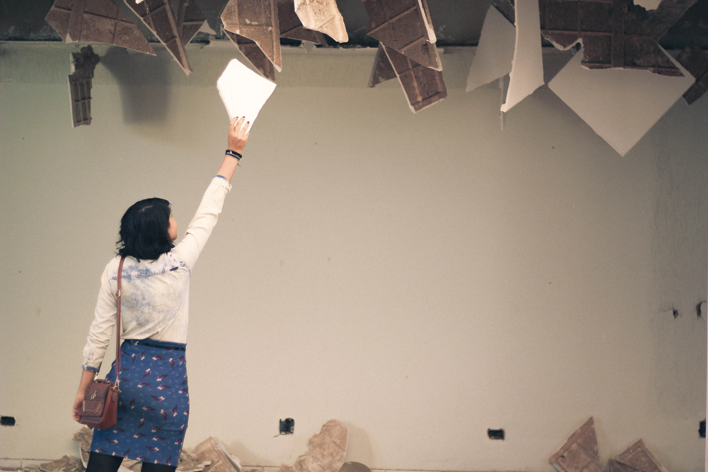
The worst part…
You will be miserable all the time
@ixek

Slide 28
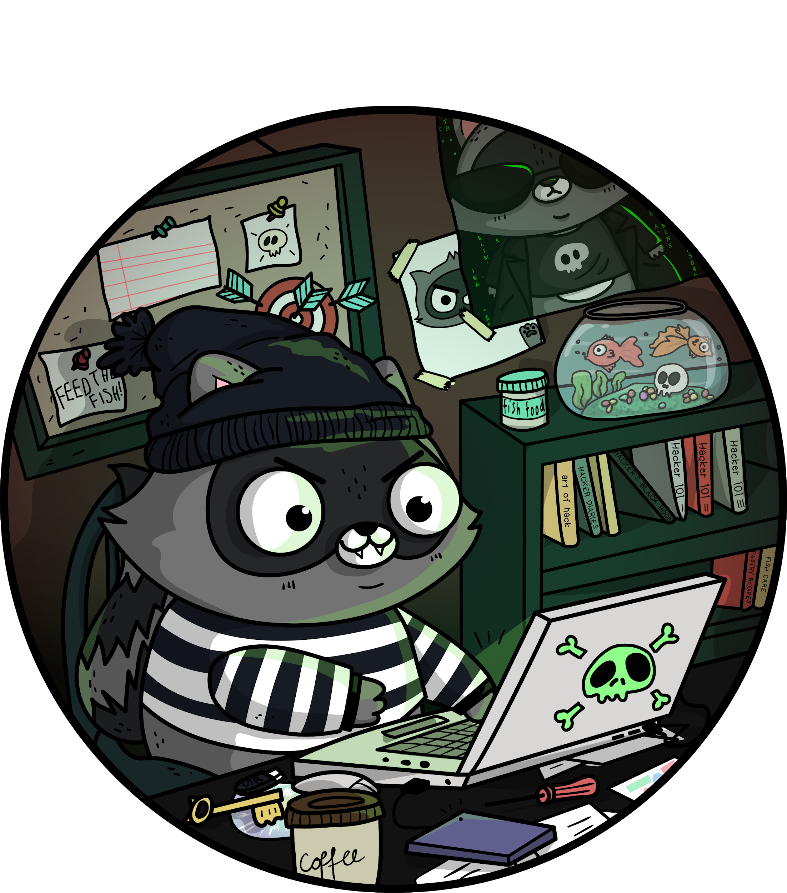
Write the Docs!!
Make the Docs valuable
Courtesy of Ashley Mcnamara
@ixek

Slide 29
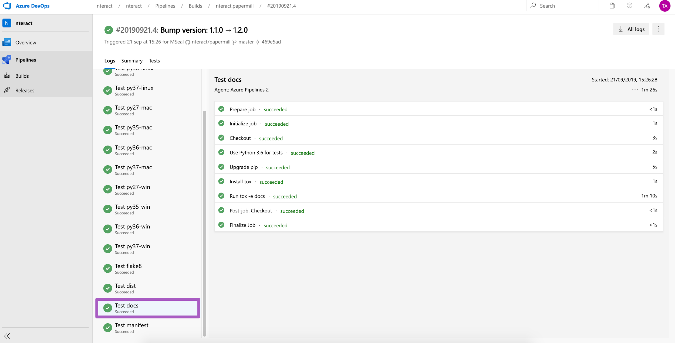
Docs are part of the work - and the pipelines
https://github.com/nteract/papermill
No job is completed if there are no docs!!
@ixek

Slide 30
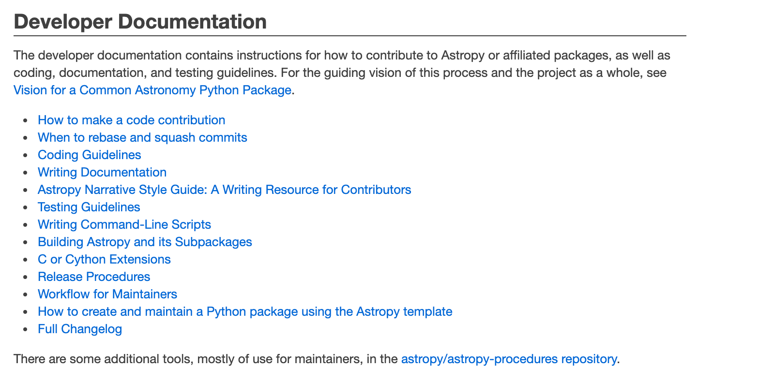
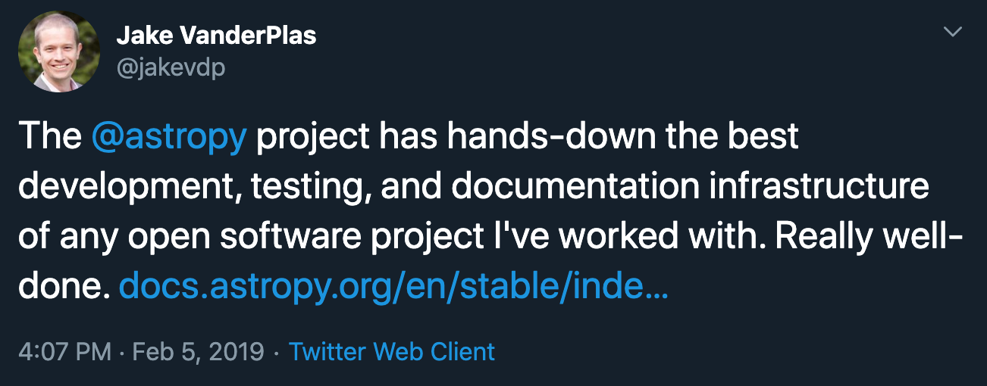
Write as if your best friend were reading
http://docs.astropy.org/en/stable/index.html#developer-documentation
@ixek

Slide 31
Problematic terms
Inclusive culture not only in your docs
Master / Slave
Blacklist / Whitelist
Primary / Replica, Captain/sailor
Denylist / Allowlist
Can have an impact in your team culture
@ixek

Slide 32
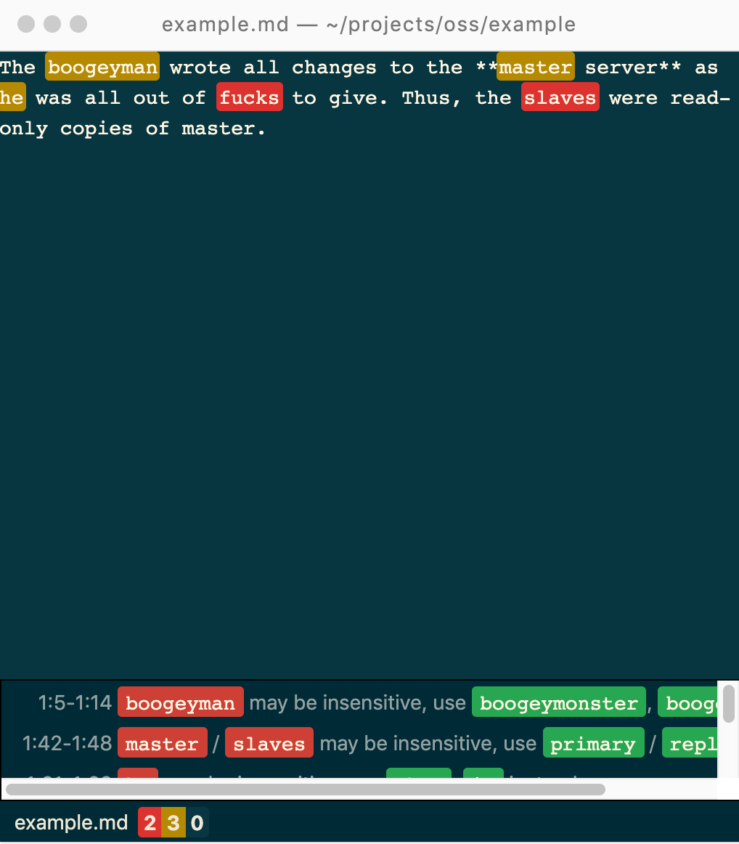
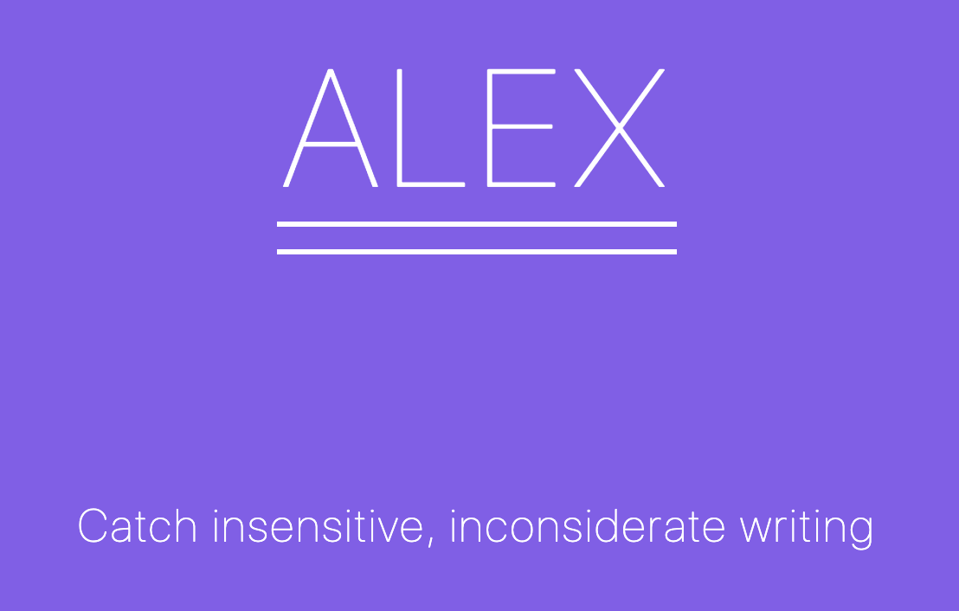
https://alexjs.com/ Visual Studio Code: vscode-alex (by @shinnn)
@ixek

Slide 33
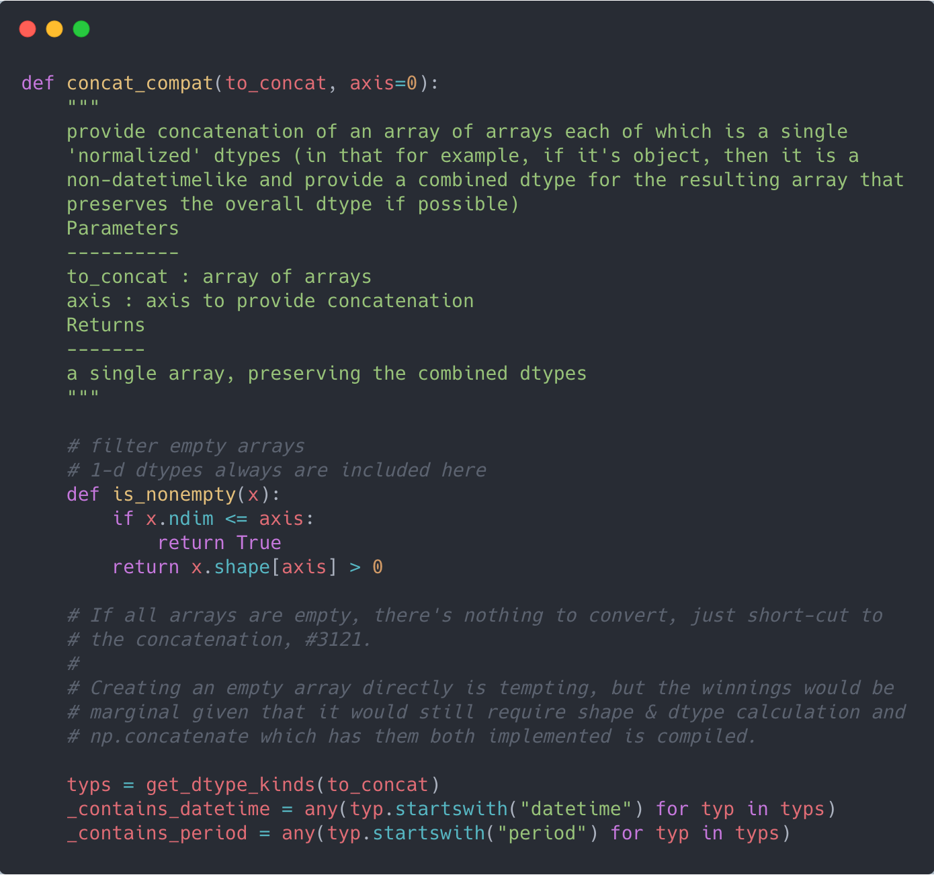
Commenting vs documentation
@ixek
https://github.com/pandas-dev/pandas/blob/18a9e4c8ab253e83ba43767d890576186be13332/pandas/core/dtypes/concat.py#L72
“Code tells you how, comments tell you why”
Jeff Atwood
Comments describe your code to developers

Slide 34
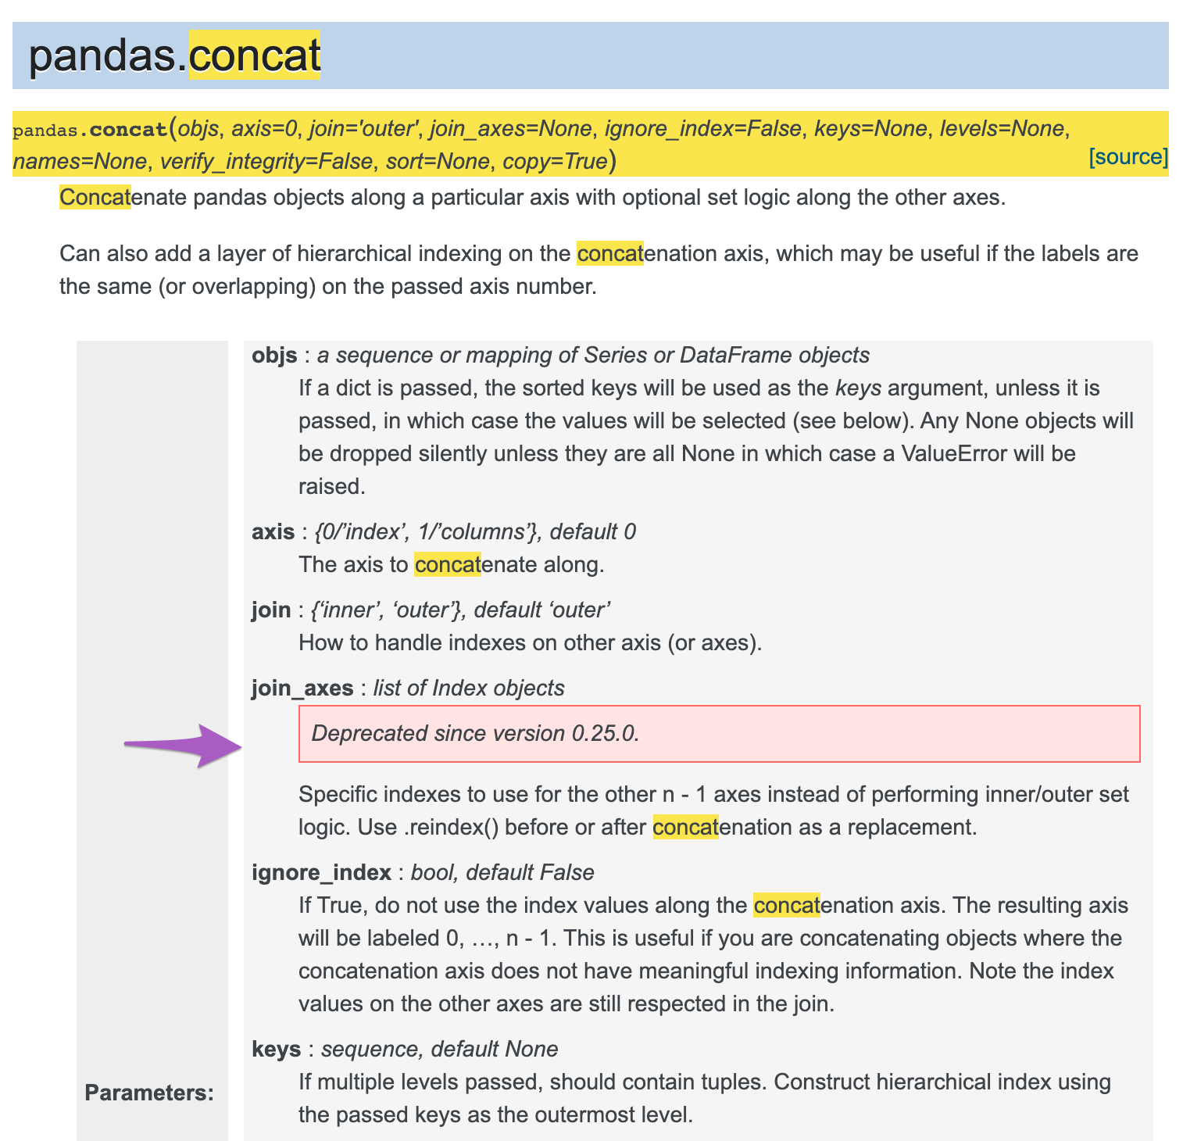
Commenting vs documentation
@ixek
https://github.com/pandas-dev/pandas/blob/18a9e4c8ab253e83ba43767d890576186be13332/pandas/core/dtypes/concat.py#L72
Docs describe its use and functionality to your users
Mindful structure:
Explain the feature
Describe the use cases
Additional recommended tooling
Common errors / gotchas

Slide 35

If you cannot use the mindful structure
https://the-turing-way.netlify.com/introduction/introduction
You might need to refactor
@ixek

Slide 36
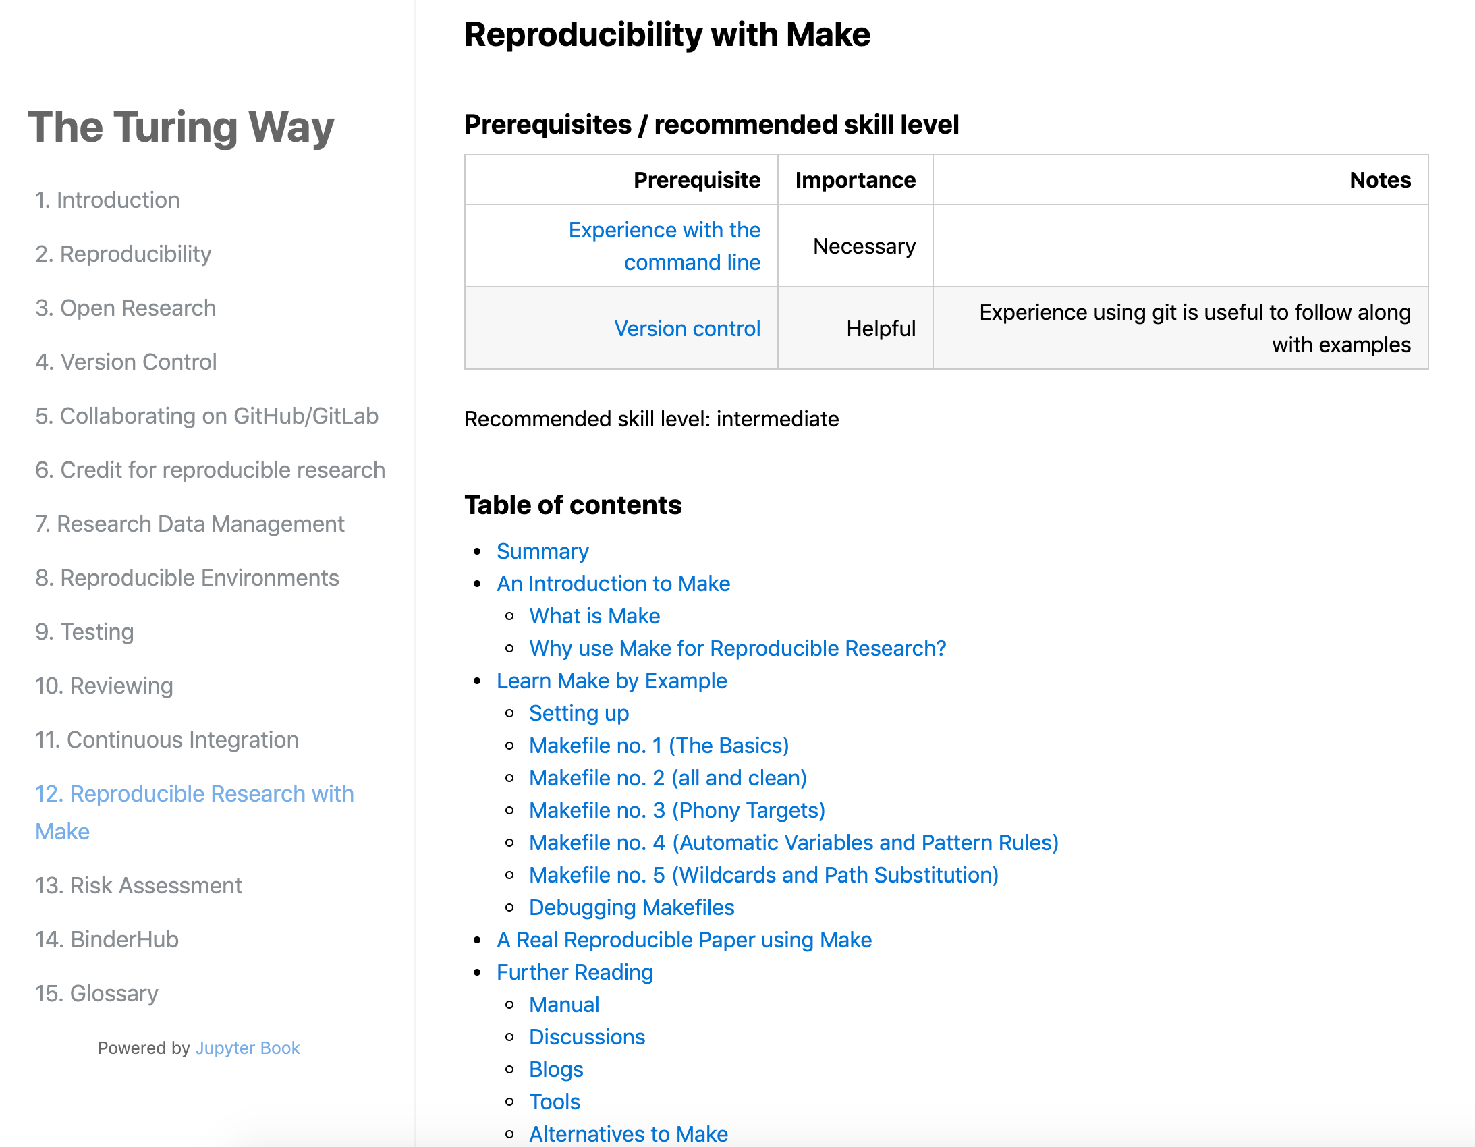
The goal of the docs
Help your users / developers to onboard and fast as possible
Make the right choice
Build trust
@ixek

Slide 37
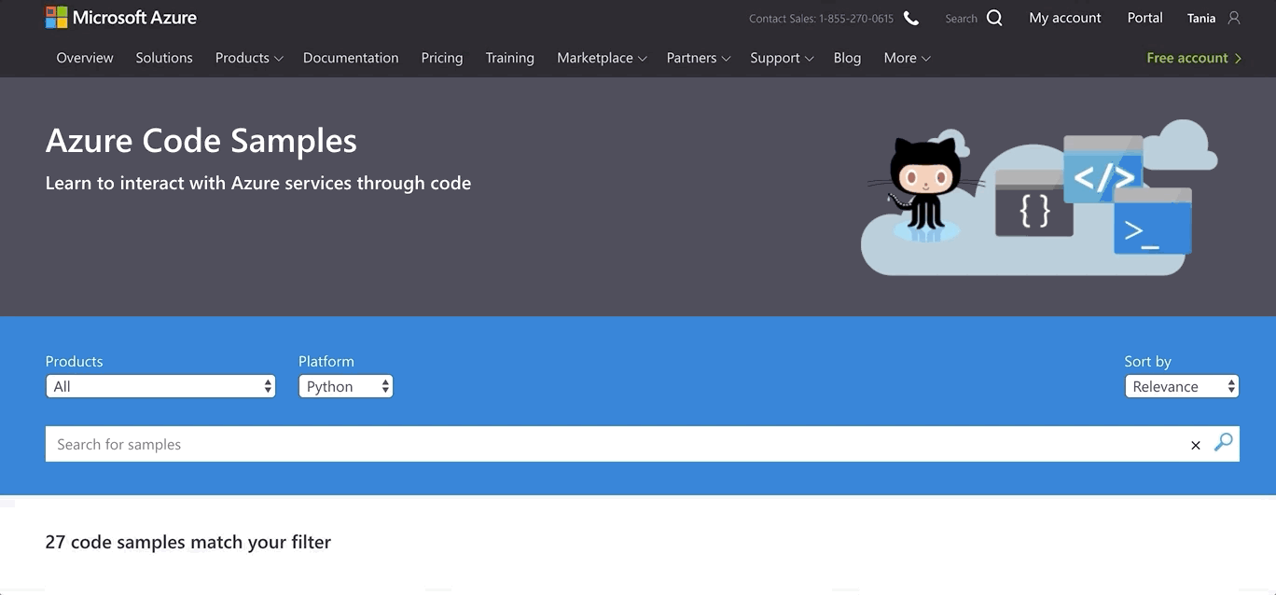
Give them useful starting points
https://azure.microsoft.com/en-us/resources/samples/?sort=0
@ixek

Slide 38
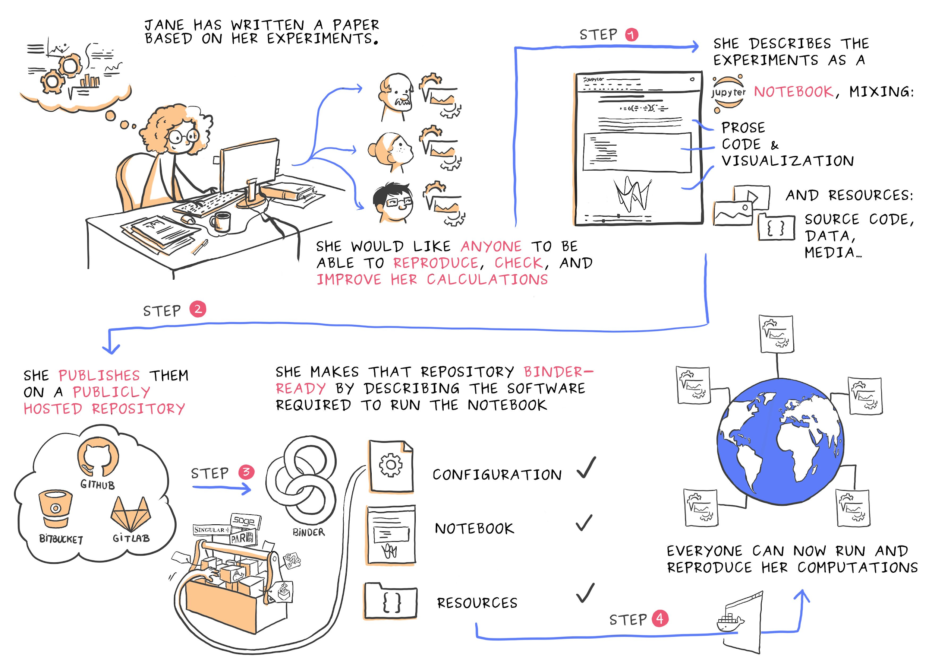
Who and why is using your tools?
https://azure.microsoft.com/en-us/resources/samples/?sort=0
Abstractions, frameworks and use cases? - does it make sense
@ixek

Slide 39
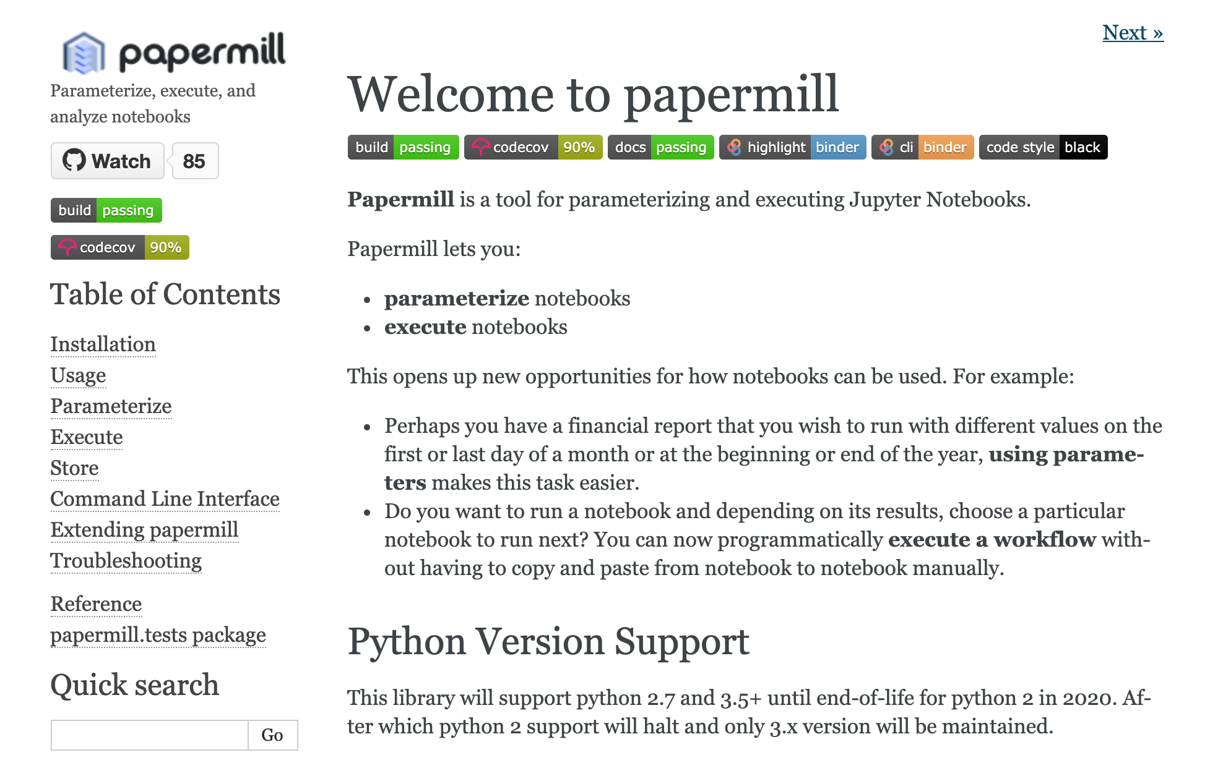
Bye bye manual docs
https://www.sphinx-doc.org/en/master/usage/quickstart.html
Because they are part of your pipelines
@ixek

Slide 40

Code sprints? Why not doc sprints?
Schedule regular timings
Bring treats!
Let them choose
Review and merge - pair native and non native speakers
@ixek

Slide 41
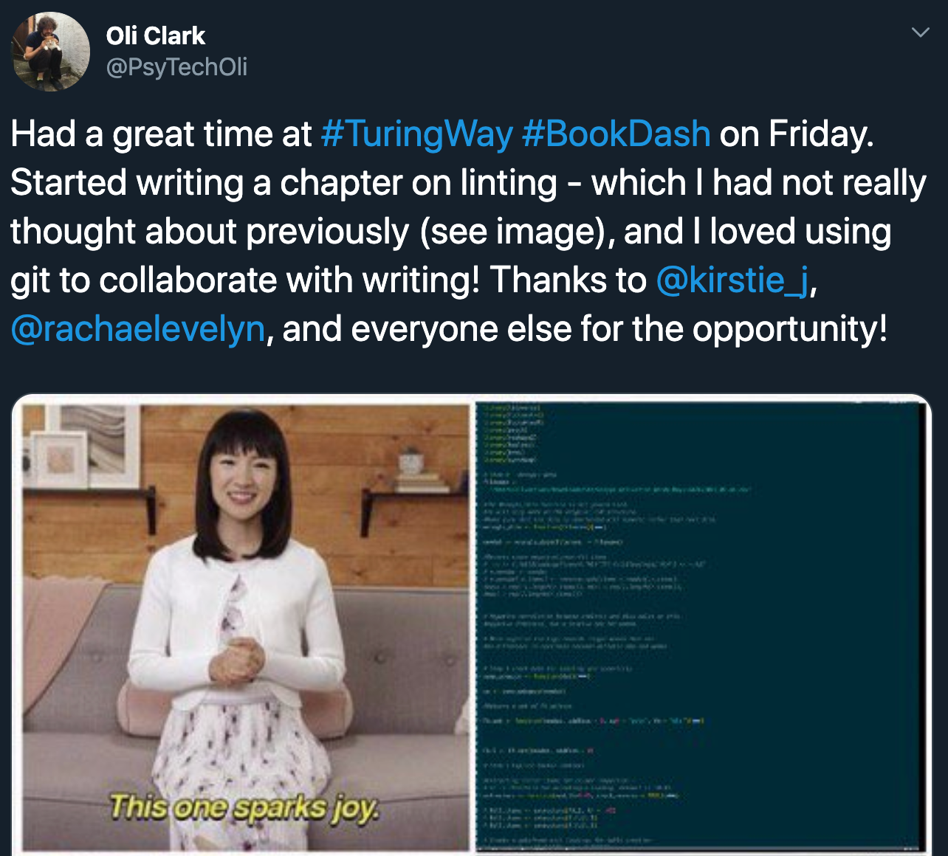
Make it a joy writing the docs
@ixek

Slide 42
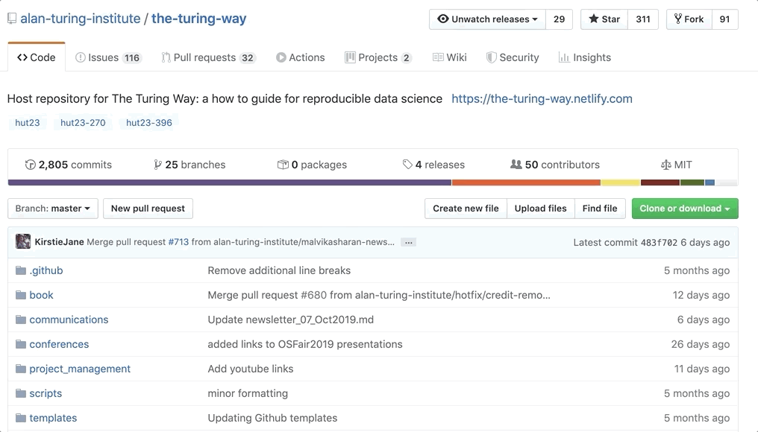
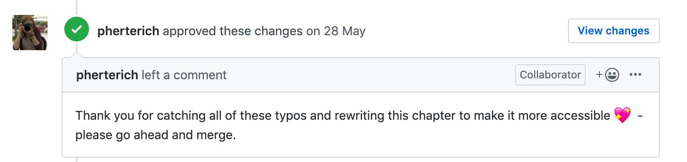
Recognise docs writers
@ixek

Slide 43



Why docs?
So why docs?
They are the door to your code and your team culture
Set the right mindset - for Pull Requests, code reviews, sprints planning
Bring people back in the process
@ixek

Slide 44



Why docs?
So why docs?
Expose code smells
Keeps institutional knowledge
Protects you against time churn
@ixek

Slide 45

happy people (developers & users)
Are more likely to stay around
@ixek

Slide 46
3 steps
To docs and culture change
@ixek

Slide 47
Accept we have a problem and stop pointing fingers
Use docs to help identify and pay technical debt
Bring people back in the process – drive the culture change
@ixek

Slide 48
Thank you & Get in touch
trallard[at]bitsandchips.me
ixek

